Slide 1
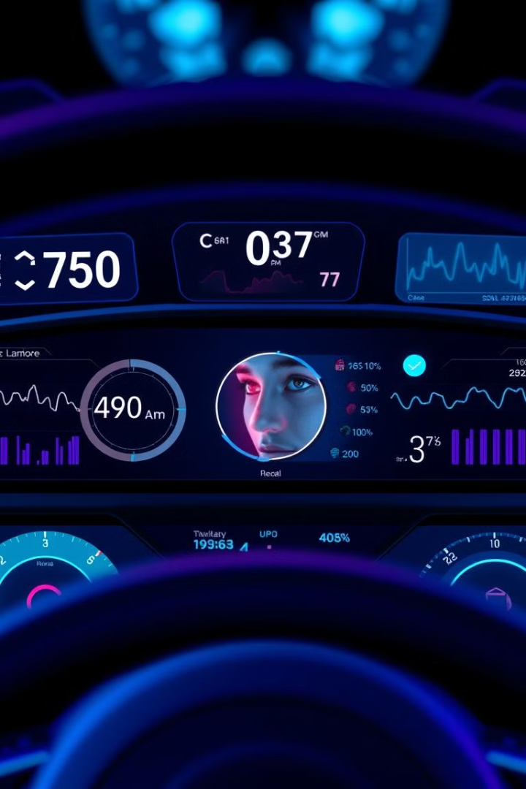
Drowsiness Detection: A Digital Signal Processing Approach
TEAM MEMBERS:
CHITTESH.S [CB.EN.U4ECE23212]
G.ROHITH [CB.EN.U4ECE23217]
HAYNISH.K [CB.EN.U4ECE23221]

Slide 2

Drowsiness Detection: Keeping You Alert
Drowsiness refers to feeling abnormally sleepy during the day. People who are drowsy may fall asleep in inappropriate situations or at inappropriate times.
Driver drowsiness detection is a car safety technology which helps prevent accidents caused by the driver getting drowsy. Various studies have suggested that around 20% of all road accidents are fatigue-related, up to 50% on certain roads.

Slide 3
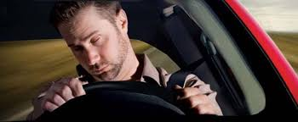
Introduction & Goal of the Project:
The purpose of the project: a system that uses a webcam to monitor eye movements and detect drowsiness, alerting the user when prolonged eye closure is detected . Detecting drowsiness through slow blinking or prolonged eye closure and triggering an alert using a beep sound.

Slide 4

Importing Essential Libraries
1
Computer Vision
The project uses OpenCV (cv2) to capture and process video from the camera.
2
Facial Analysis
dlib is used to detect faces and locate key facial features like the eyes.
3
Mathematical Tools
scipy and numpy provide the necessary mathematical functions for analyzing eye movement patterns.
4
Audio Alerts
The winsound library is used to play a beep sound when drowsiness is detected.

Slide 5
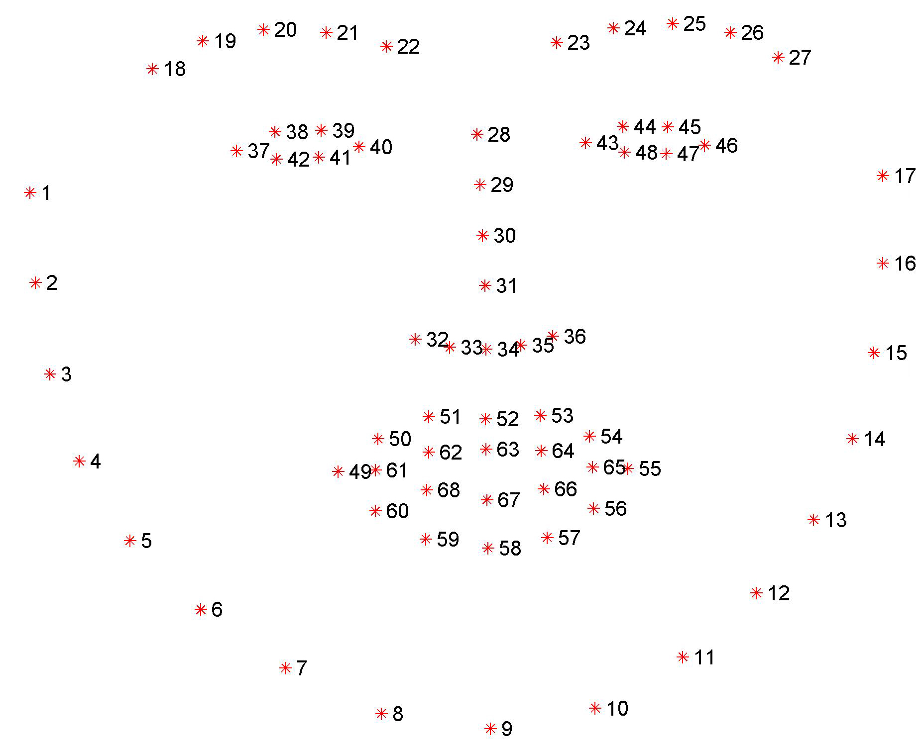
dlib’s facial landmark detector
The pre-trained facial landmark detector inside the dlib library is used to estimate the location of 68 (x, y)-coordinates that map to facial structures on the face.
Facial landmarks are used for localizing and representing salient regions or facial parts of the person’s face, such as:
Nose
Jaws
Left eye
Right eye
Left eyebrow
Mouth
Right eyebrow

Slide 6
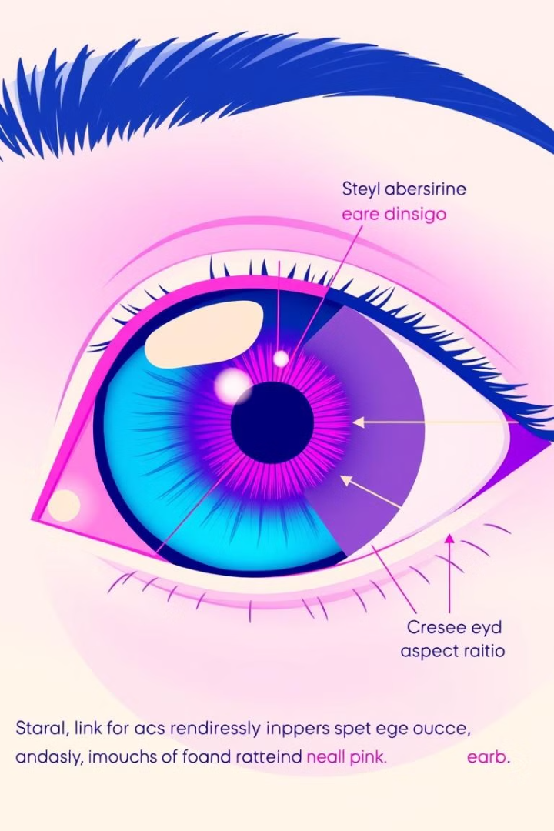
Calculating Eye Aspect Ratio (EAR)
1
Eye Landmarks
The program uses dlib to detect 6 key points around the eye, which are used to calculate the Eye Aspect Ratio (EAR).
2
EAR Calculation
The EAR is a ratio that represents how open or closed the eye is. A higher EAR indicates the eye is more open, while a lower EAR means the eye is more closed.
3
Drowsiness Detection
By monitoring changes in the EAR over time, the program can detect signs of drowsiness, such as prolonged eye closure or slow blinking.

Slide 7
INITIALIASING THE VARIABLES
• eardata : This keeps a record of how much your eyes are open (calculated by the EAR)
.• framecount : This counts how many frames (individual pictures taken from the camera feed) have been analyzed
.•samplingrate: The program doesn’t check every frame but takes a snapshot every 10th frame
•fftWindowSize: This limits the number of snapshots (120 frames in this case) used for detecting patterns in your eye movements.

Slide 8
Collecting and Analyzing Eye Movement Data
EAR Data Collection
FFT Analysis
Drowsiness Detection
The program records the EAR values every 10 frames, storing the most recent 120 values in a list called earData.
Once there are 120 EAR values, the program uses the Fast Fourier Transform (FFT) to analyze the patterns in the eye movements, focusing on low-frequency patterns that indicate drowsiness.
If the low-frequency patterns in the EAR data are strong enough, the program determines that the user is becoming drowsy and triggers an alert.

Slide 9
CONCEPTS OF DIGITAL SIGNAL PROCESSING
SAMPLING :
*Sampling refers to capturing data at specific intervals, transforming a continuous signal (like eye openness) into discrete values.
*The project doesn’t analyze every single video frame but instead takes a snapshot every 10th frame (controlled by the sampling Rate variable). This is a form of down sampling, where only some data points are kept for processing to reduce computational load and make real-time analysis feasible.
WINDOWING:
The program maintains a buffer (window) of the last 120 EAR values. As each new sample is added, the oldest one is removed. This windowed data is used for pattern analysis with FFT. The concept ensures that the system is continuously analyzing the most recent eye movement data.

Slide 10
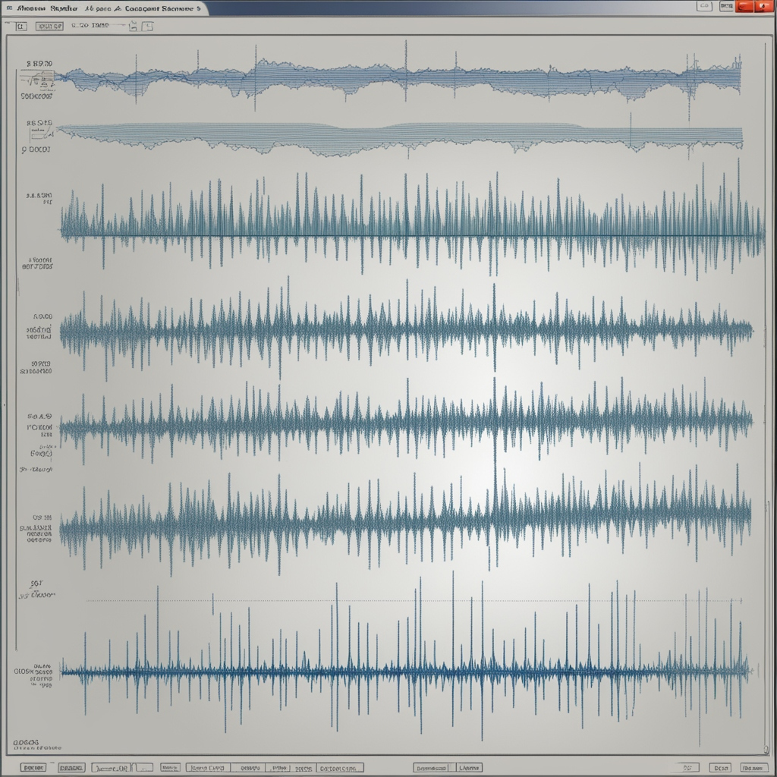
FFT (Fast Fourier Transform) for Drowsiness Detection
Once there are 120 EAR values (frames) stored:
The FFT tool is used to analyze how your eye openness has changed over time.
FFT turns these 120 EAR values into frequencies (patterns of how fast or slow your eyes are opening and closing).
The program focuses on low frequencies (slow movements), which often indicate prolonged eye closure or slow blinking, both signs of drowsiness.

Slide 11
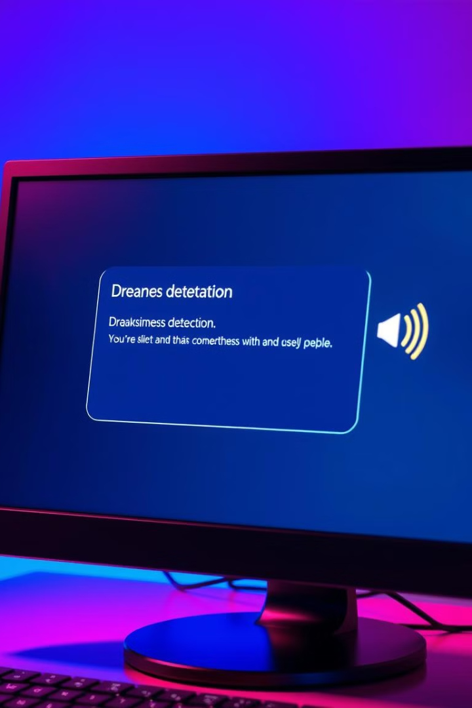
Alerting the User
Visual Warning
When drowsiness is detected, the program displays a warning message on the screen to alert the user.
Audio Alarm
The program also plays a beeping sound to further grab the user's attention and help them stay awake.
Customizable Settings
The frequency and duration of the beep can be adjusted to suit the user's preferences and needs.

Slide 12





Capturing and Processing Video
Video Capture
The program uses the computer's camera to capture a live video feed.
Image Resizing
The video frames are resized to a smaller size for faster processing.
Grayscale Conversion
The video frames are converted to grayscale to simplify face and eye detection.
Face and Eye Detection
The program uses dlib to detect faces and locate the user's eyes in the video feed.

Slide 13
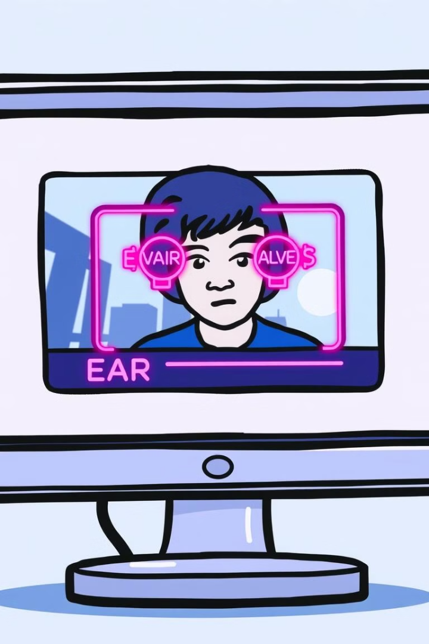



Visualizing Eye Movements
Eye Tracking
The program draws outlines around the user's eyes to visually indicate that it is tracking their movements.
EAR Visualization
The current EAR value is displayed on the screen, providing a real-time indication of the user's eye openness.
Drowsiness Alert
If the program detects signs of drowsiness, it displays a warning message on the screen.

Slide 14


